Slide 1
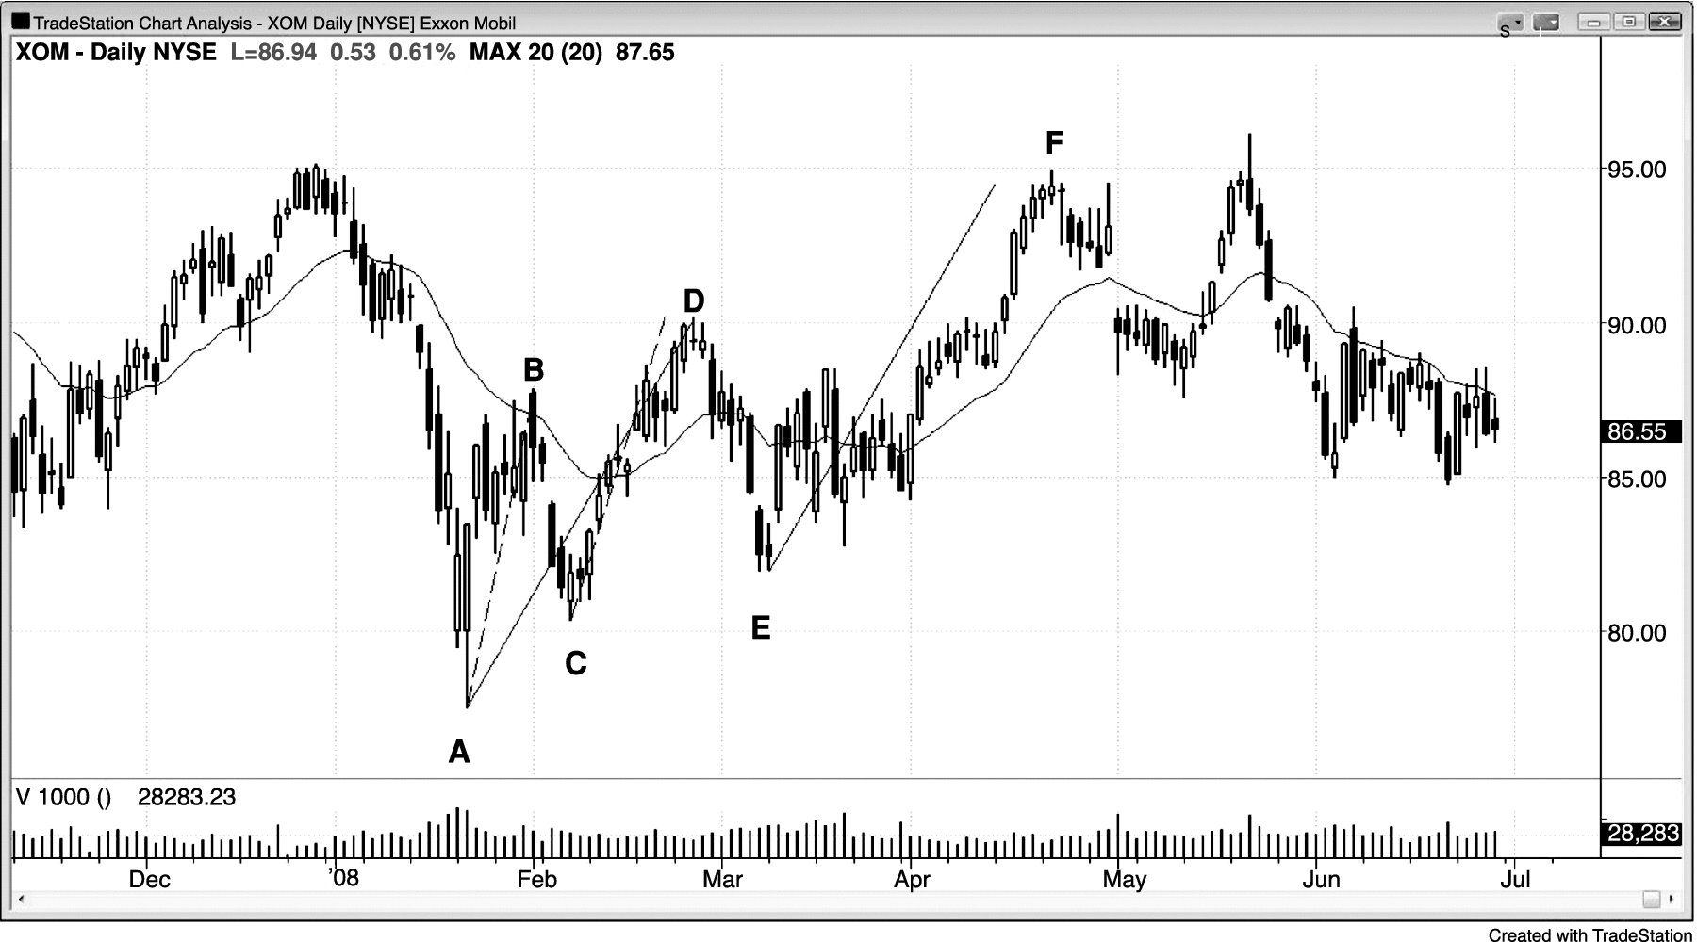
FIGURE 7.1 Leg 1 = Leg 2

Slide 2
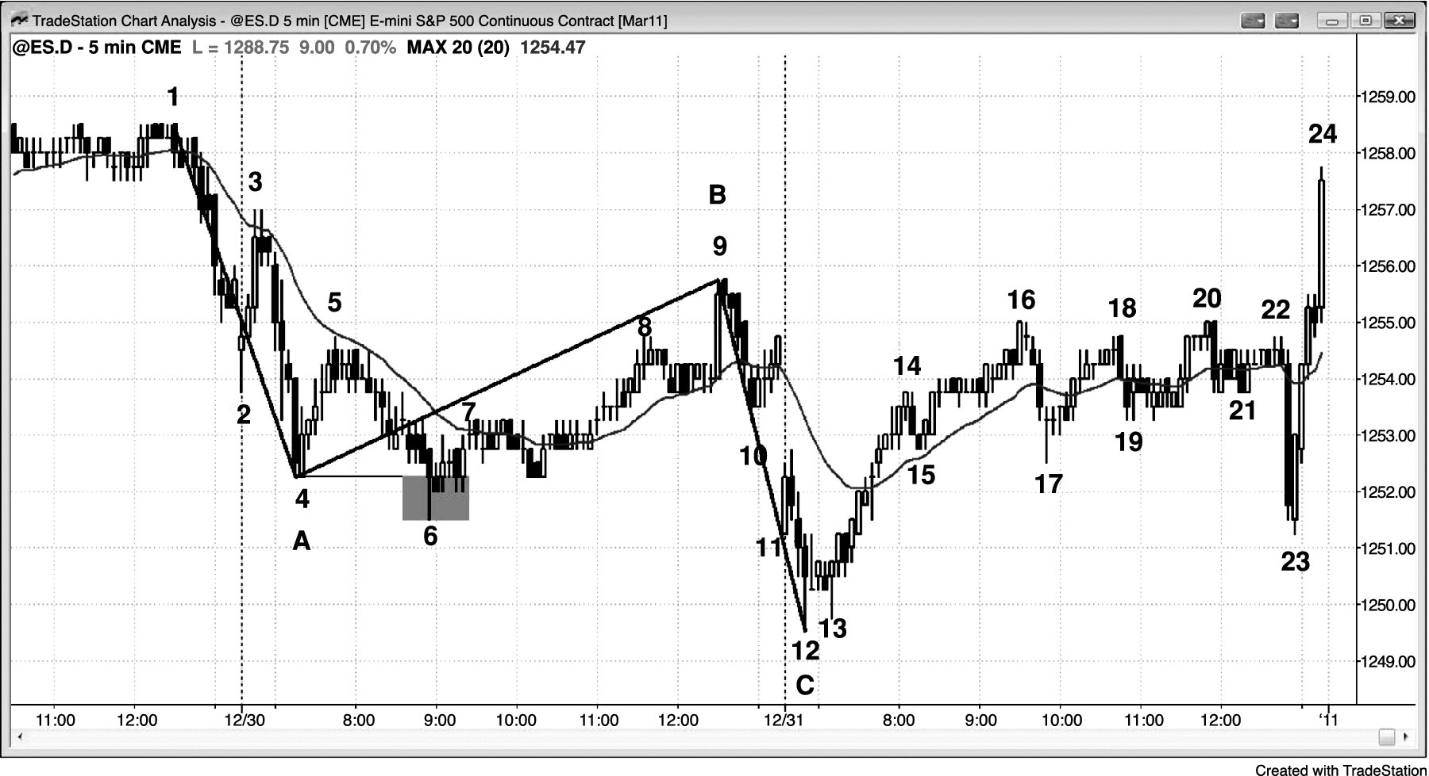
FIGURE 7.2 Variant of Leg 1 = Leg 2

Slide 3
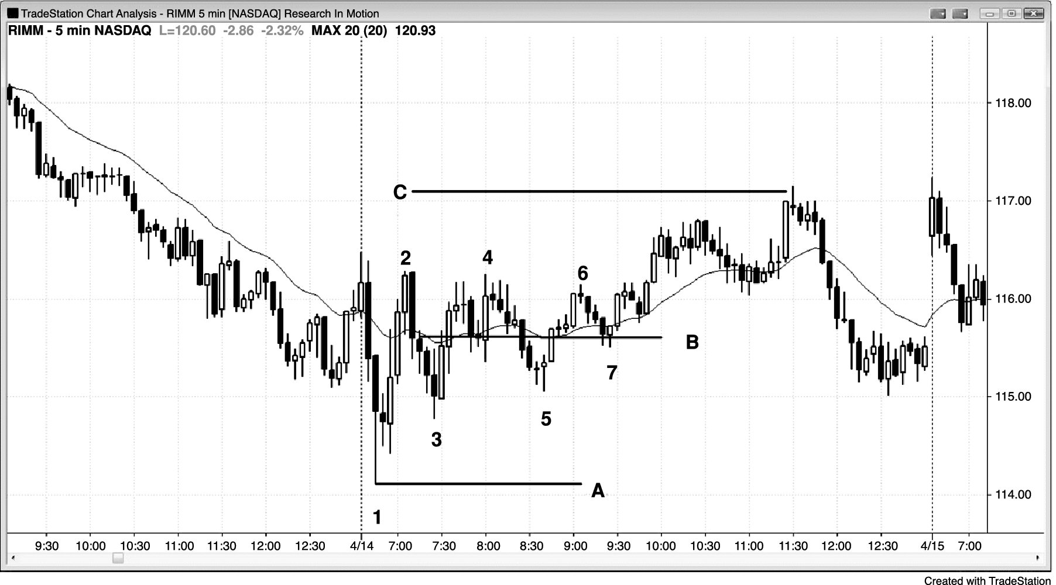
FIGURE 7.3 Measured Move Based on Middle of Trading Range

Slide 4
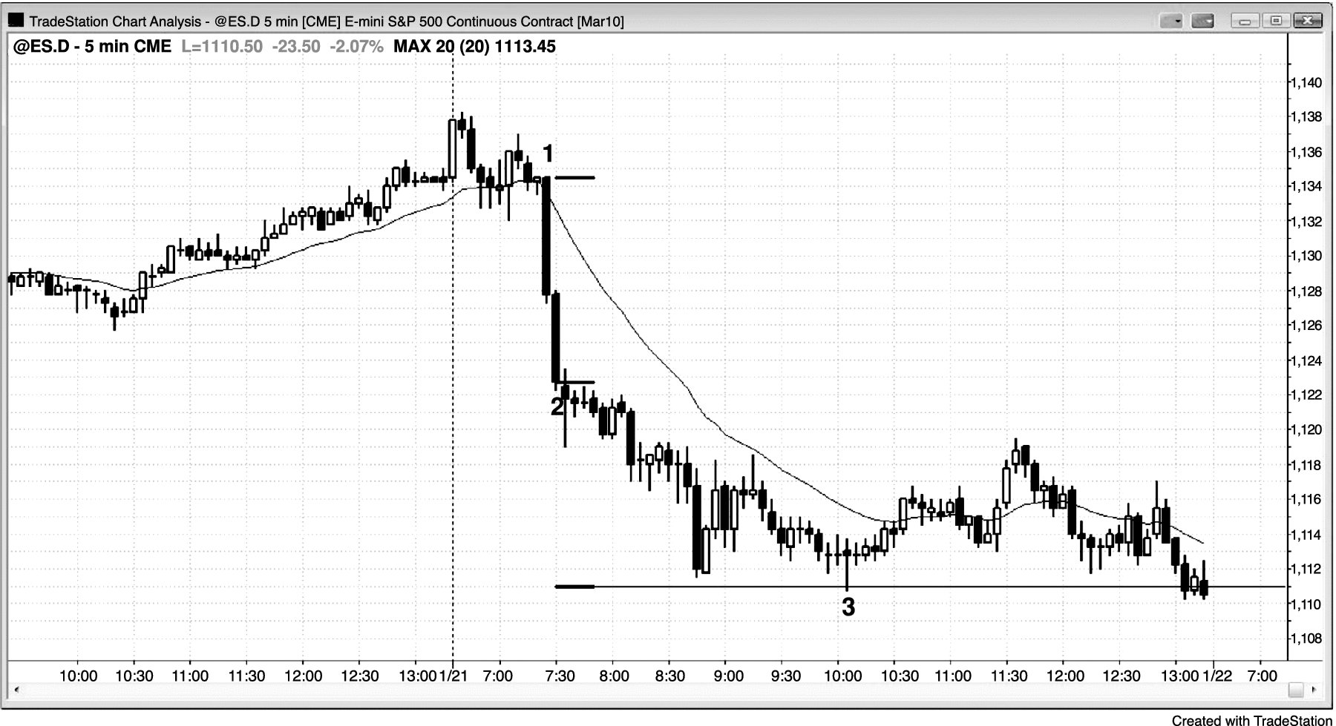
FIGURE 7.4 Measured Move Based on Bear Spike

Slide 5
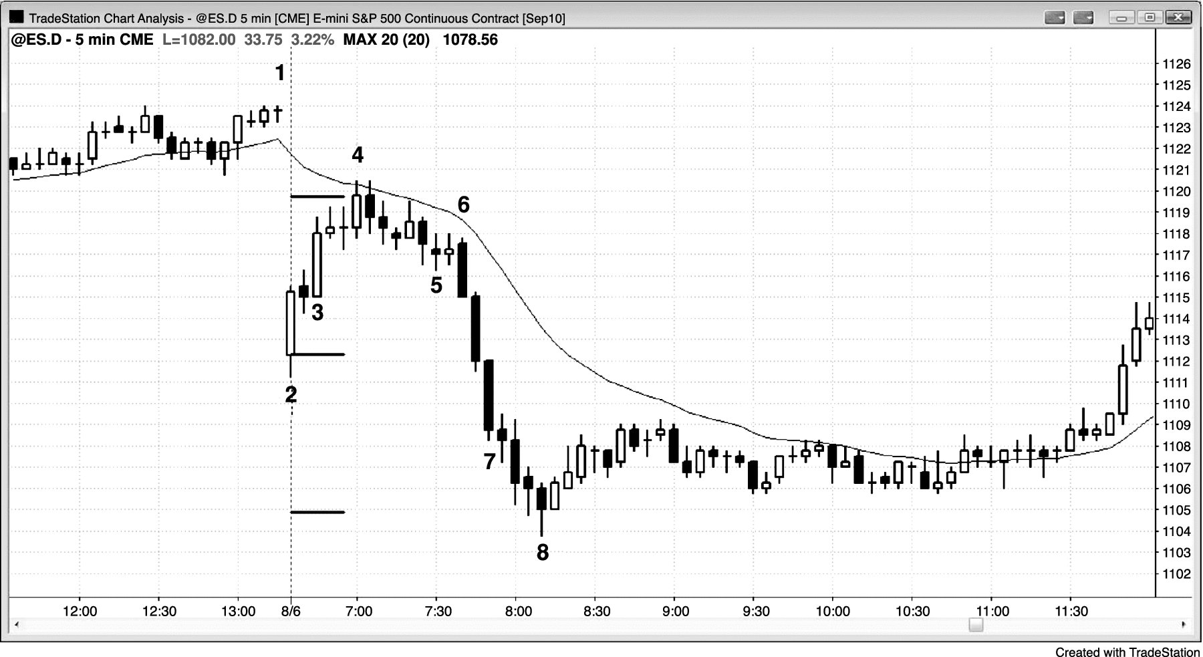
FIGURE 7.5 A Spike Can Lead to a Measured Move Up or Down

